Slide 1
Final Presentation Emergency Social Network
Team SA-8
Yang Zhou
Yiting Shen
Yifan Li
Haoxiang Gao
Changda Li

Slide 2
Vision
The vision of the system is creating a social network in which people can communicate with others, share status, find nearby people and share nearby events in emergencies like Earthquake via mobile phone.

Slide 3
Functionality: User Story Motivation
Share Location
As a citizen in emergency,
Add Event
As a citizen in emergency,
Find Nearby Events
As a citizen in emergency,
I want to share my location and find nearby people on map
so that I can chat privately with people nearby and ask helps from them.
I want to add new events and upload photo of events on map
so that I can notify other citizens of the emergency events
I want to find nearby events on map
so that I can be aware of emergency events nearby and check out details and photos of these events.

Slide 4
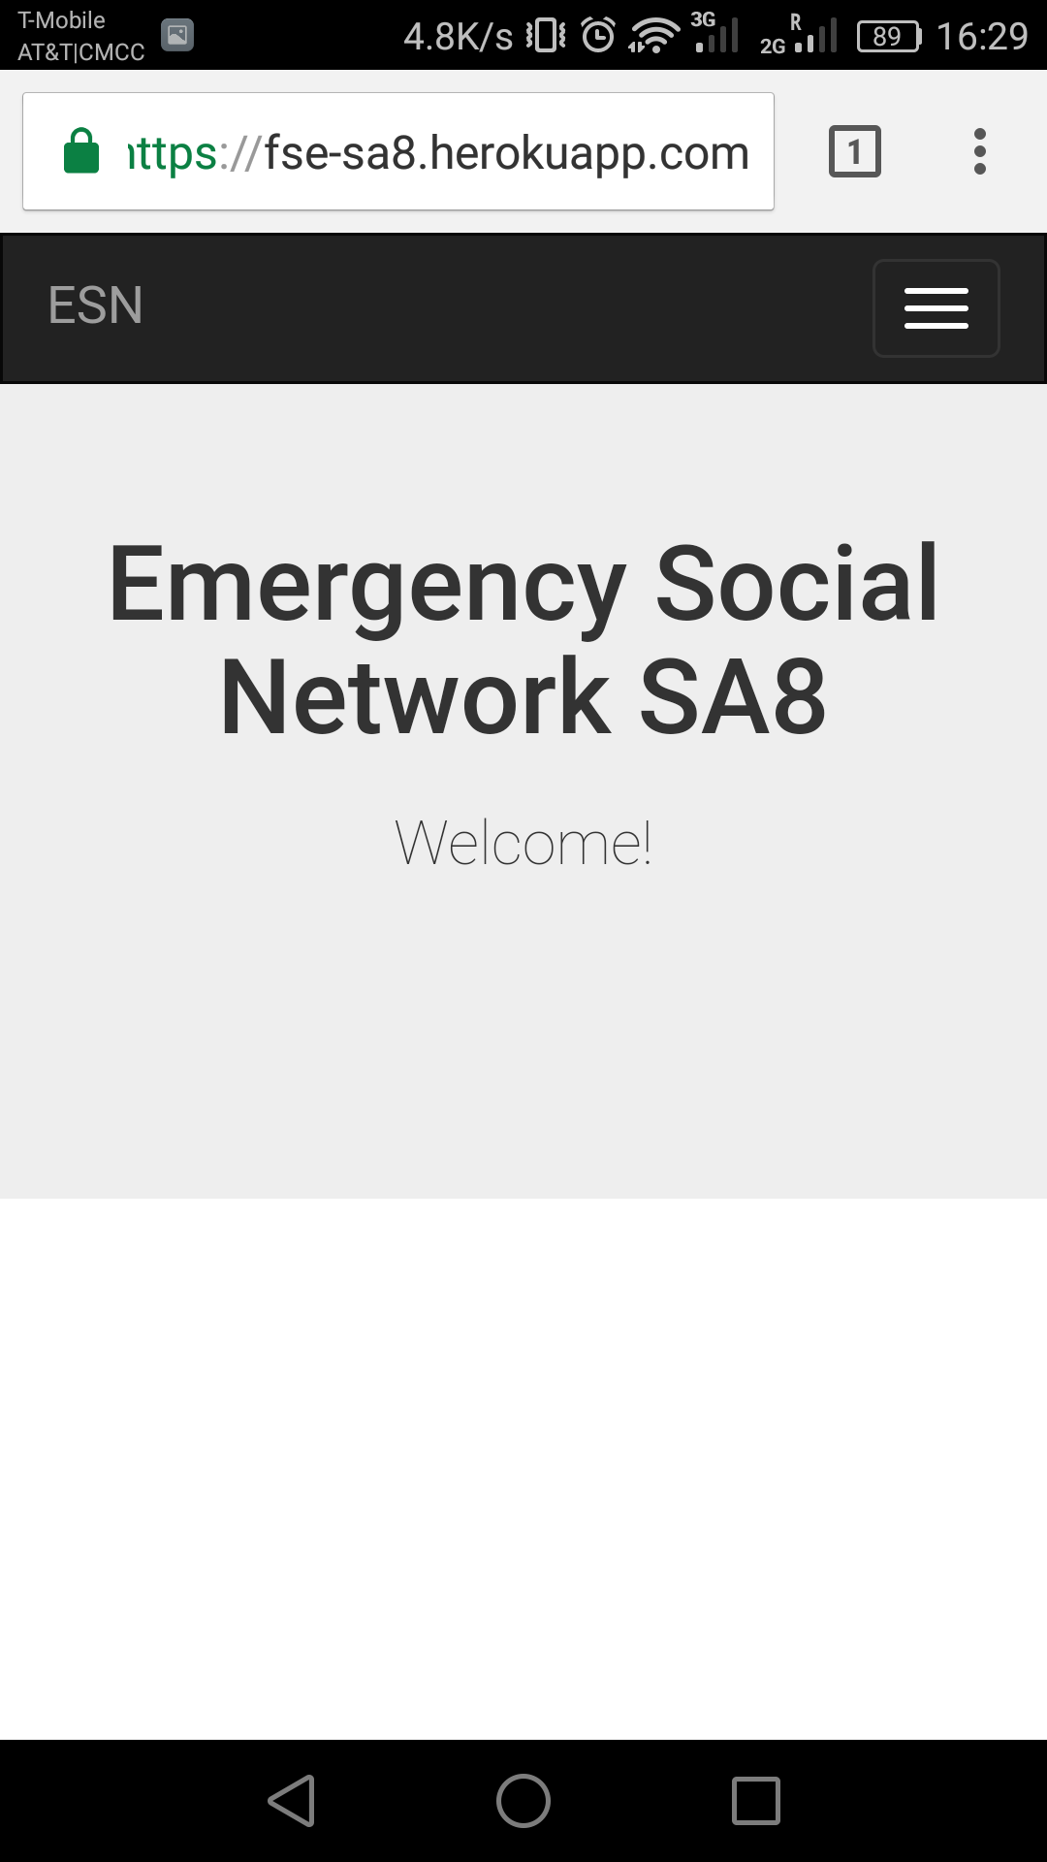
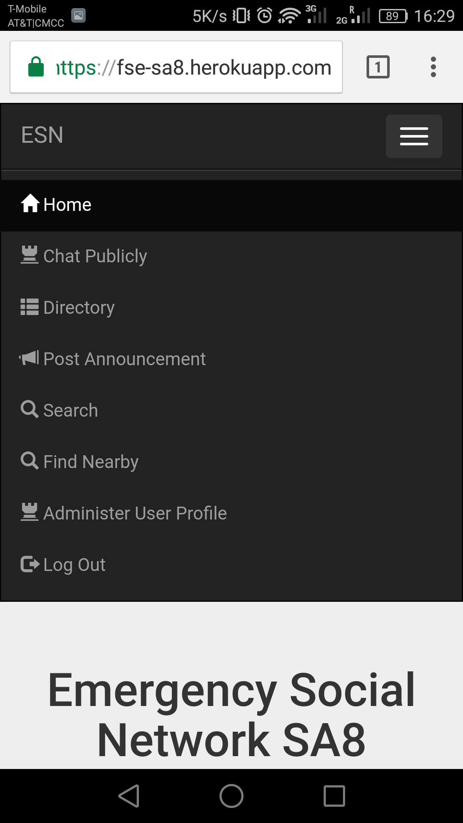
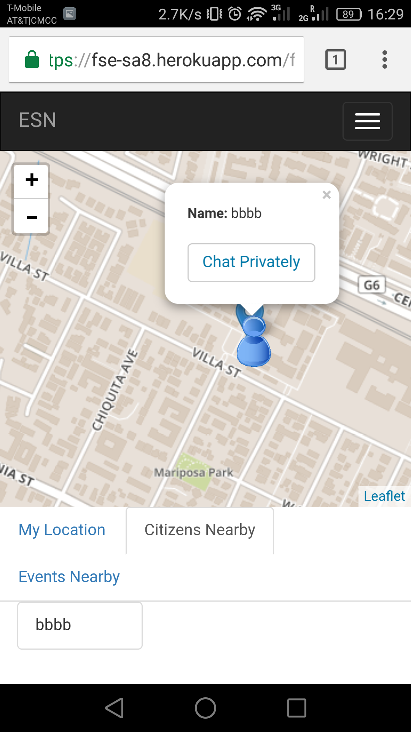
Functionality: Screenshots
Share my location and find nearby people on map

Slide 5
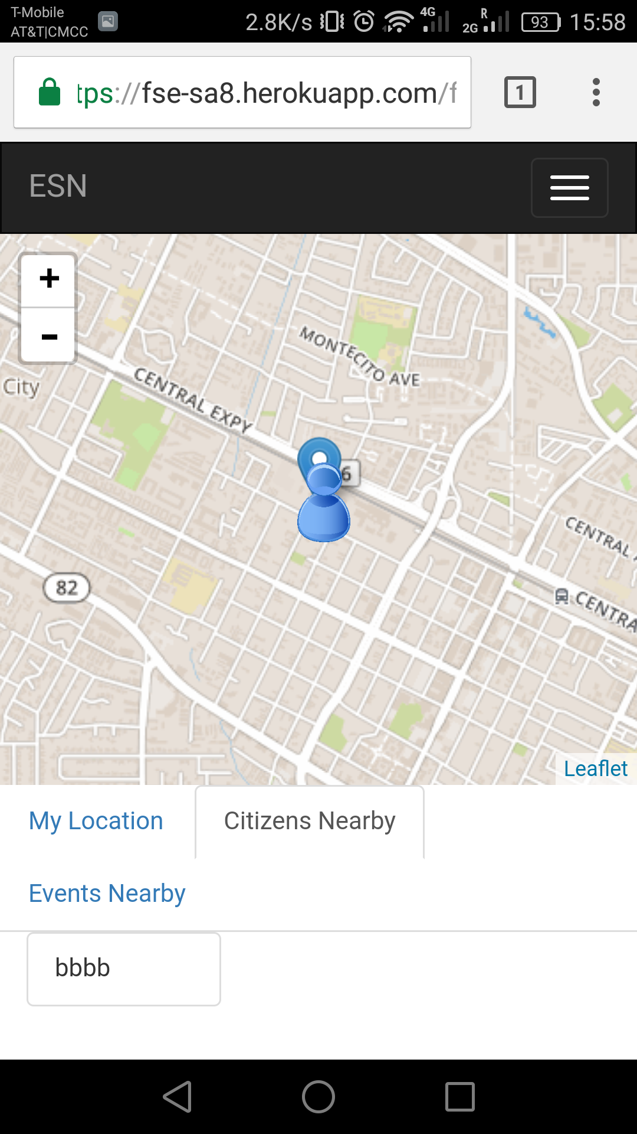
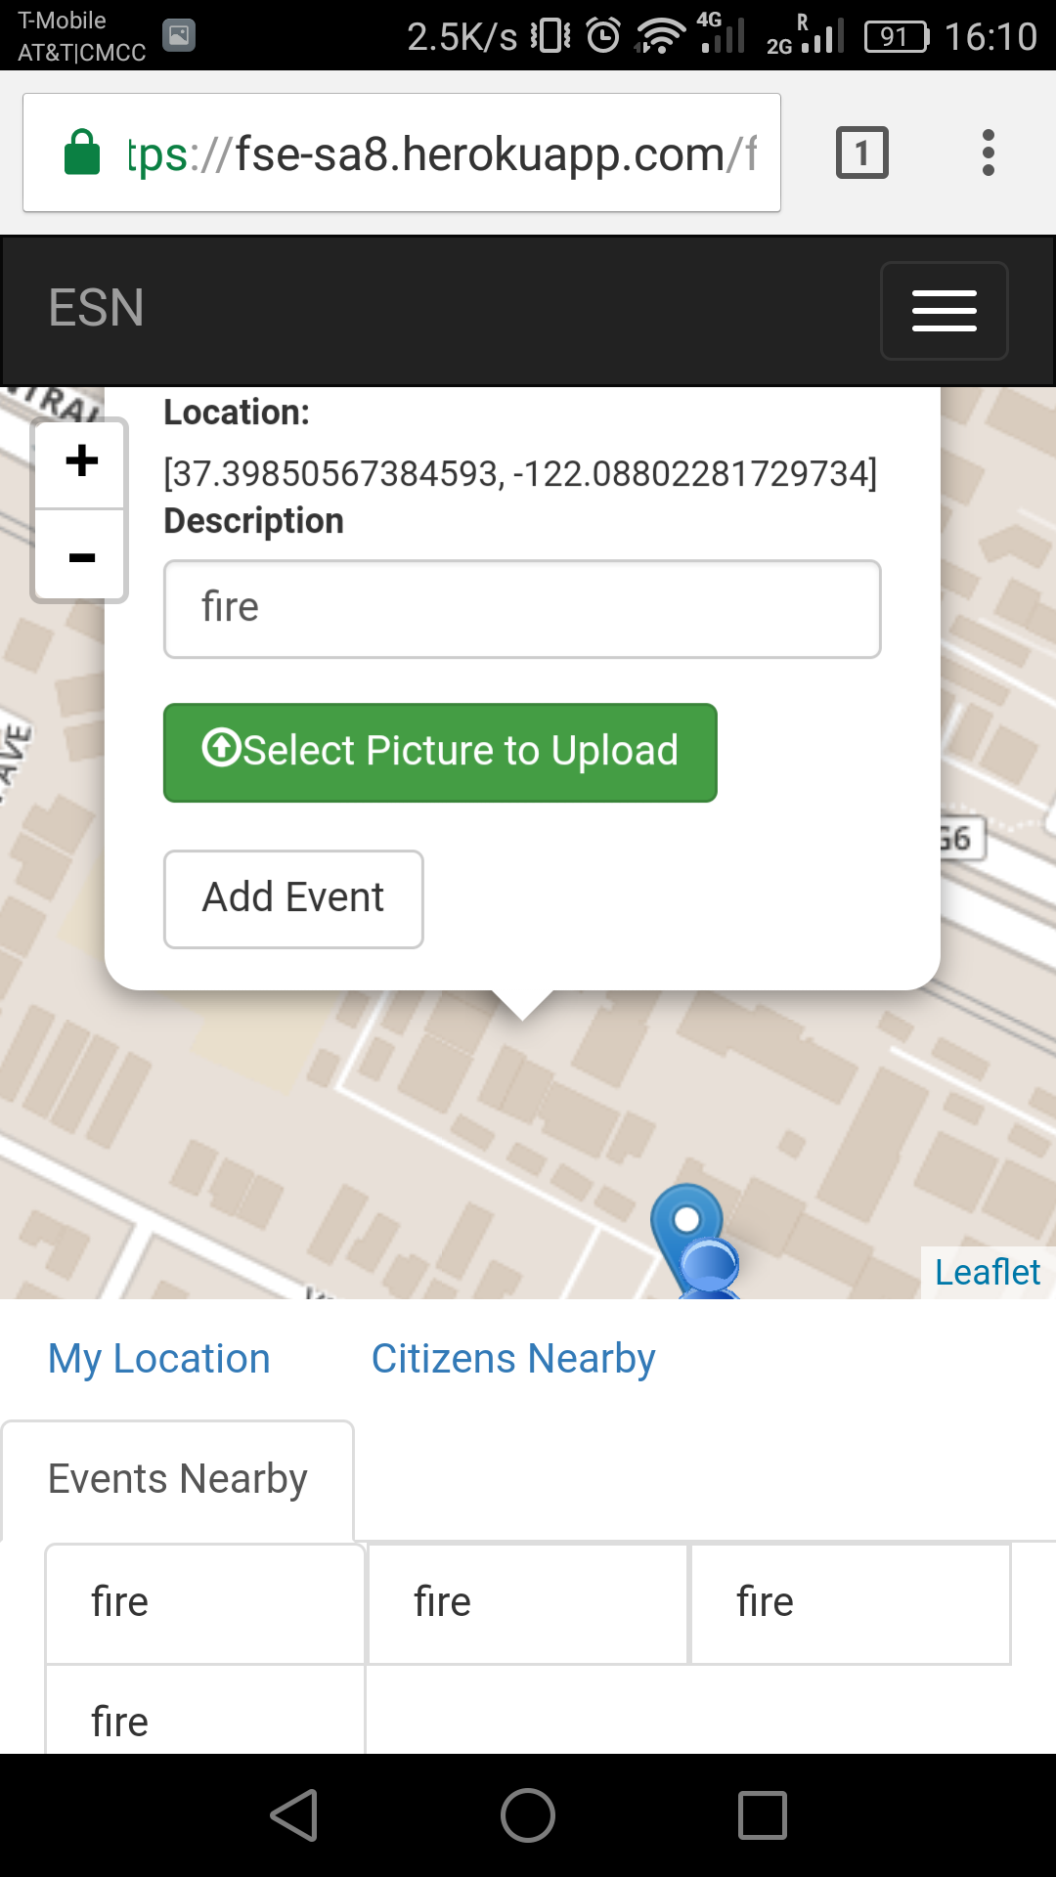
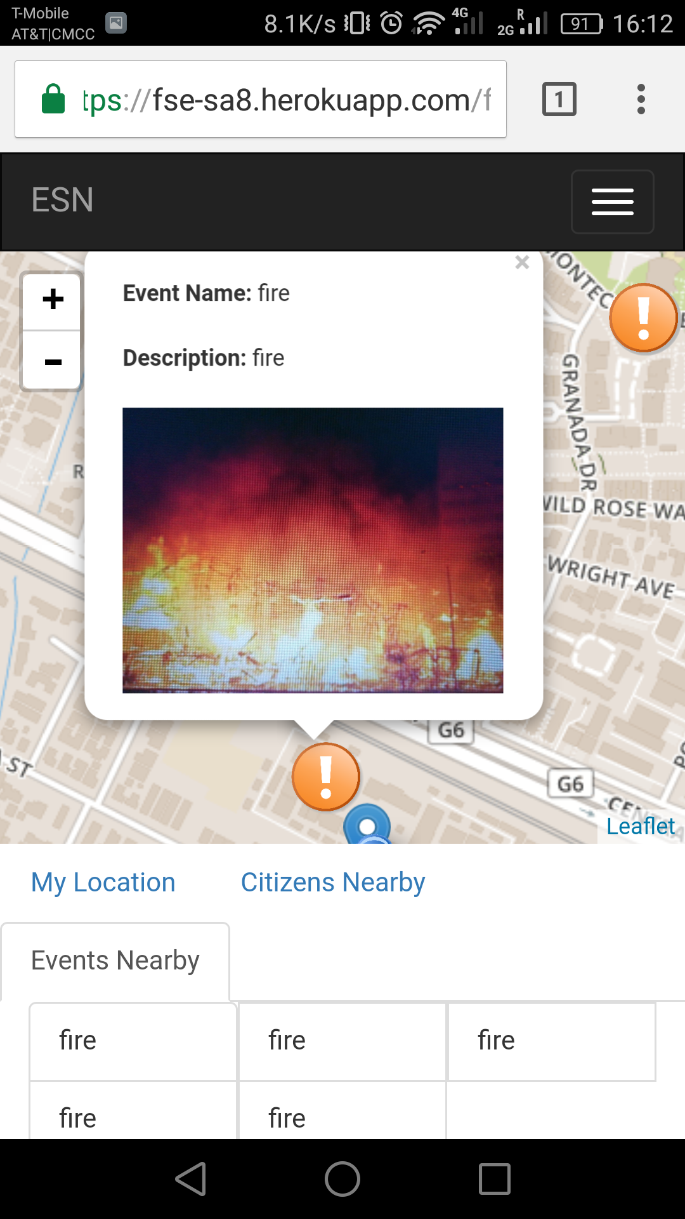
Functionality: Screenshots
Add new events and upload photo of events on map
Find nearby events on map

Slide 6
Quality Attributes
Security:
Middleware, Password Encryption
Extensibility:
Bridge, React.js
Usability

Slide 7
Quality Attributes
Security - Password Encryption:
crypto-js/sha256: SHA256 is common, fast and enough powerful(password is at least 4 character long)
Using a mature encryption technology is secure
Impact: provides security benefits during transmission
var hashedpass = CryptoJS.SHA256(pass).toString(CryptoJS.enc.Hex);

Slide 8
Quality Attributes
Security - Middleware:
Passport.js
Authenticate session, password, account status and privilege
Authenticate in every API
Impact: Improve efficiency of managing users’ status and privilege. If a user’s account has some changes on status, privilege, etc., the users would have a immediately impact.

Slide 9
Quality Attributes
Extensibility:
Bridge : Database
Bridge pattern decouples an abstraction from its implementation
Impact: Can extend the abstraction and implementation hierarchies independently
React.js
Using React.js to render views of chatPublicly, chatPriately, etc.
Impact: By unifying markup with its corresponding view logic, React can actually make views easier to extend

Slide 10
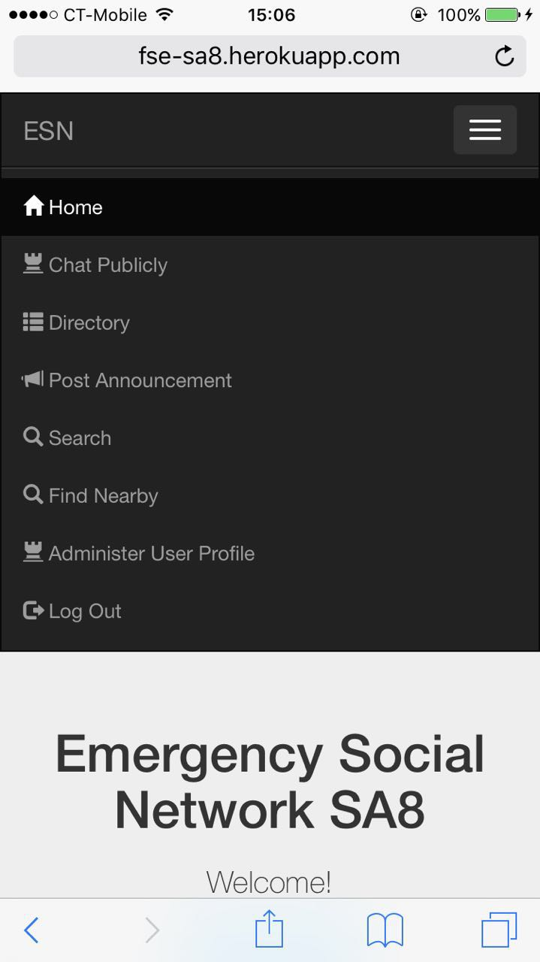
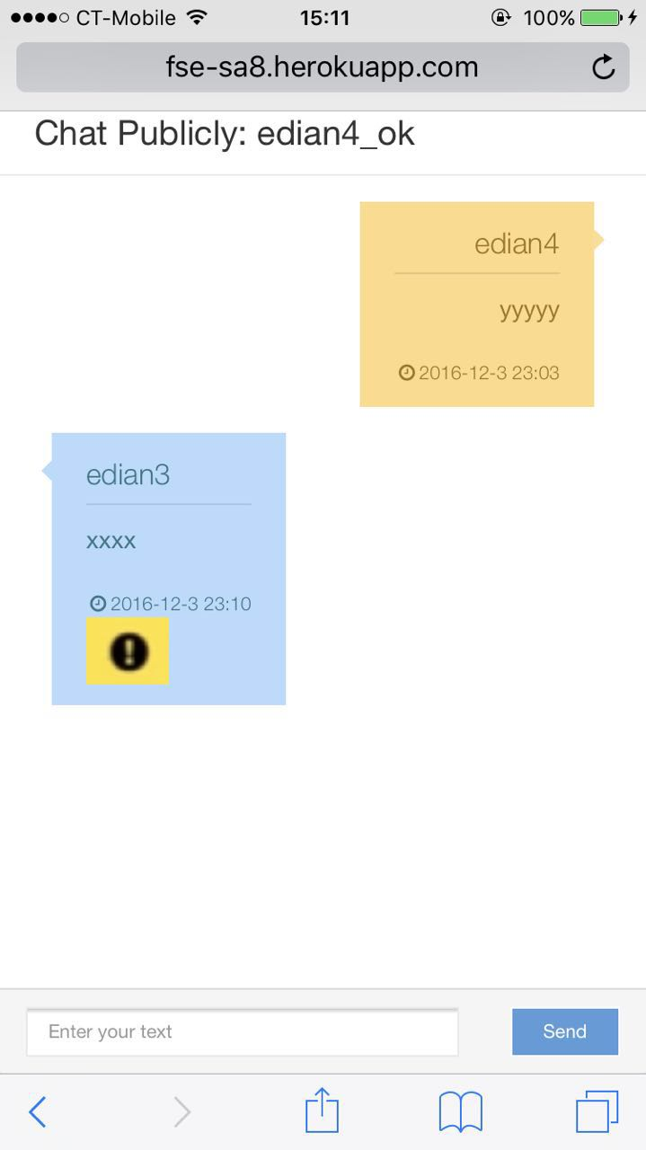
Quality Attributes
Usability:
Easy to learn
Efficiency
Engaging

Slide 11
Code & Tests
LOC (excluding libraries and framework)
Backend: 1, 446
Frontend (exclude CSS stylesheets): 1, 537 + 633 (views)
Tests: 1, 815
Number of Tests :
Unit tests: 24
Integration tests: 29
UI tests

Slide 12
Code Coverage
72.07% Statements 627/870
41.6% Branches 99/238
72.53% Functions 132/182
73.25% Lines 627/856

Slide 13
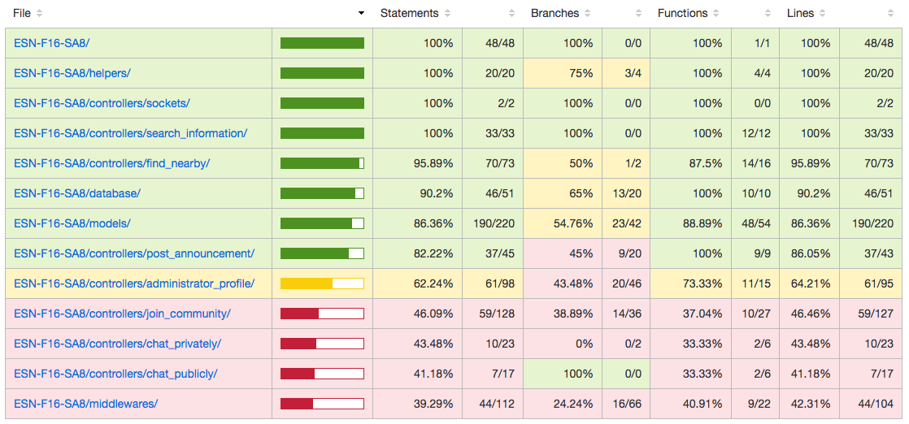
Code Coverage

Slide 14
How to Test
Test Database
Prepare the test triggered data (stimuli) in the test database
Clear database before every test
Not affect the actual production database
Protect the user data
Black Box Testing
Test all of the functionalities are done
White Box Testing
Aim to cover all of the paths – Code Coverage
Continuous Integration entails test automation

Slide 15
What to test
Functionality
If the behaviors are expected
Quality Attributes - Security
Especially for integration test
Privilege
Login user or no-login user
Active or Inactive
Citizen, Coordinator and Administrator

Slide 16
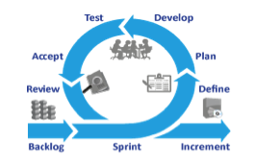
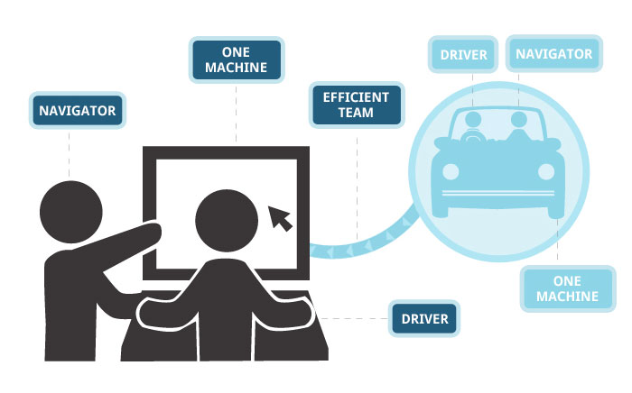


Software Engineering Practices
Scrum Method
Sprint Planning
Trello Board: Products Backlog, Sprint Backlog, Burndown Chart
Review and Retrospective
Pair Programming
Driver-Navigator
Shared knowledge of technologies and code base
Pair Pressure and good quality
Continuous Integration/Continuous Deployment
Commit often, build often
Detect integration problems early
Incremental delivery
Version Control
Pull Request
Feature Branches
Issue Tracking

Slide 17
Use MVC as main software architecture
MODEL
/models
VIEW
/views
USER
CONTROLLER
/controllers
MANIPULATES
UPDATES
USES
SEES

Slide 18

Use Basic Tech + ReactJS
Basic Tech
ReactJS: make frontend codes reusable
EJS
HTML
JS
JQUERY
BOOTSTRAP
CSS

Slide 19
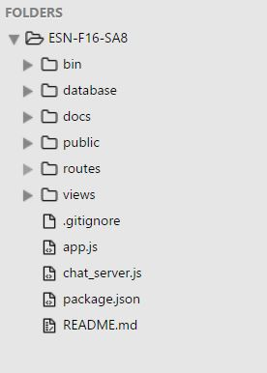
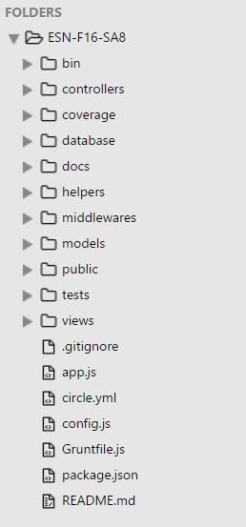
Lessons Learned: Apply good design at the beginning
Before refactoring
After refactoring

Slide 20
Lessons Learned: Use layering methodology to divide work
HTML
JS
NodeJS

Slide 21
Question & Answer

